Slide 1
Deep dive into Transformers
Amirhassan Amirmahani - Gholamreza Dar

Slide 2

Transformer Architecture
Transformer architecture
Encoder and Decoder stack
Self-attention
Multihead attention
Positional encoding
Residual connections
Encoder - Decoder Attention
Encoder Attention Vs Decoder Attention (Masking)
The final Linear and Softmax layers
Training
One Hot Encoding
Loss Function
Another Training Method

Slide 3

Transformer as a black box
http://jalammar.github.io/illustrated-transformer/

Slide 4

Inside a Transformer
http://jalammar.github.io/illustrated-transformer/

Slide 5

Encoder and Decoder Stacks
http://jalammar.github.io/illustrated-transformer/

Slide 6

Inside Encoder and Decoder Units
http://jalammar.github.io/illustrated-transformer/

Slide 7
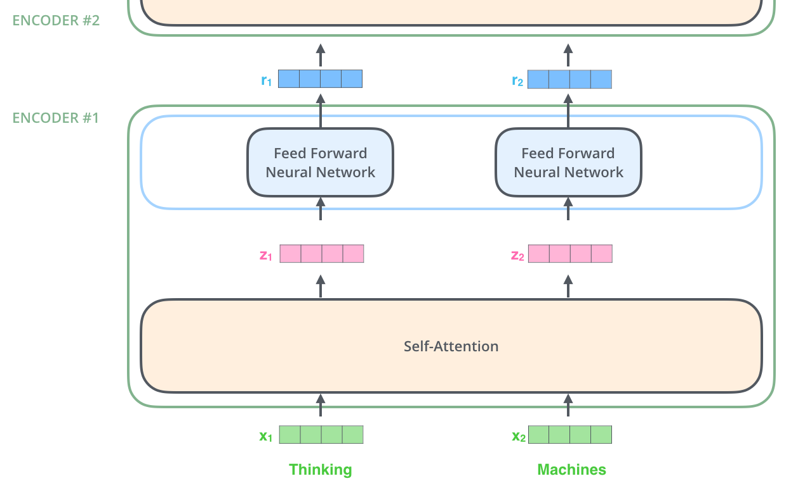
Encoding
http://jalammar.github.io/illustrated-transformer/

Slide 8

Self-attention
”The animal didn't cross the street because it was too tired”
http://jalammar.github.io/illustrated-transformer/

Slide 9
Tensor2Tensor by Google Brain team
Tensor2Tensor, or T2T for short, is a library of deep learning models and datasets designed to make deep learning more accessible and accelerate ML research.
https://colab.research.google.com/github/tensorflow/tensor2tensor/blob/master/tensor2tensor/notebooks/hello_t2t.ipynb

Slide 10

Self-attention in more detail
http://jalammar.github.io/illustrated-transformer/

Slide 11
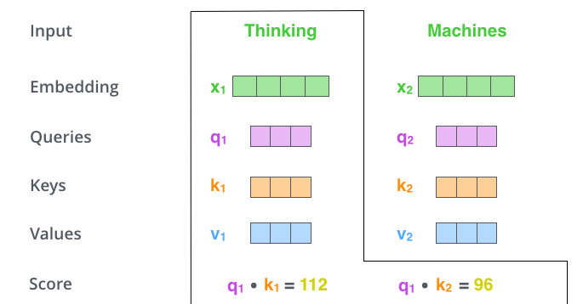
Second step : Score
http://jalammar.github.io/illustrated-transformer/

Slide 12
Second step : Score
http://jalammar.github.io/illustrated-transformer/

Slide 13
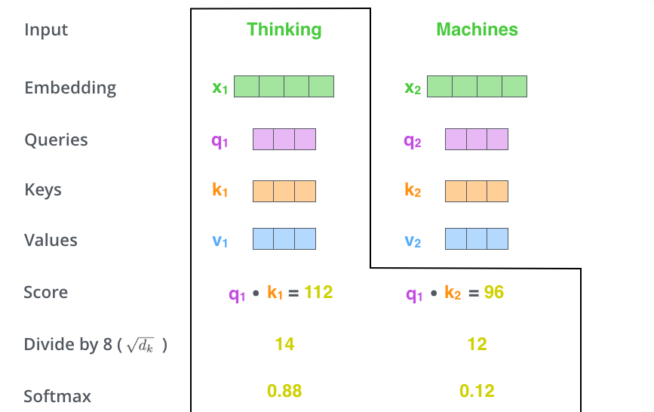
Third step : Divide by 8
http://jalammar.github.io/illustrated-transformer/

Slide 14
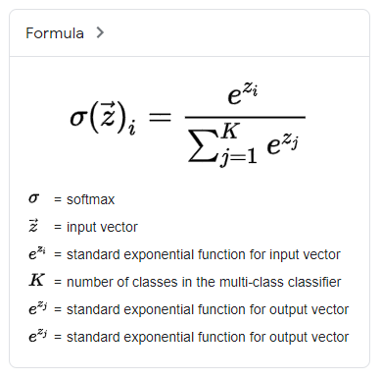
Fourth step : Softmax
google.com
http://jalammar.github.io/illustrated-transformer/

Slide 15
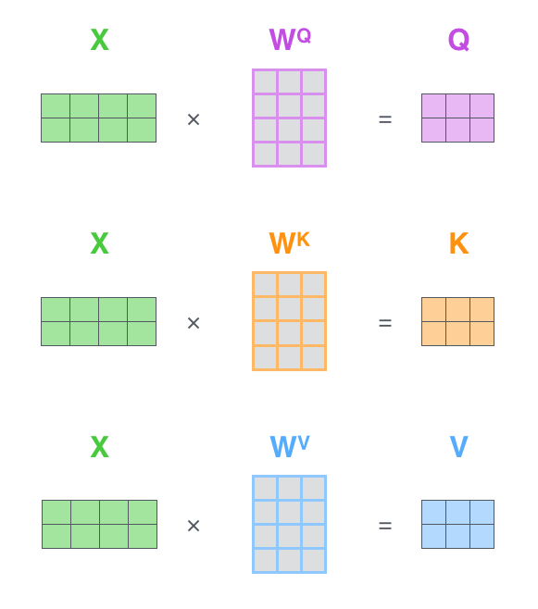
Matrix Representations
http://jalammar.github.io/illustrated-transformer/

Slide 16

Self-attention Formula
http://jalammar.github.io/illustrated-transformer/

Slide 17
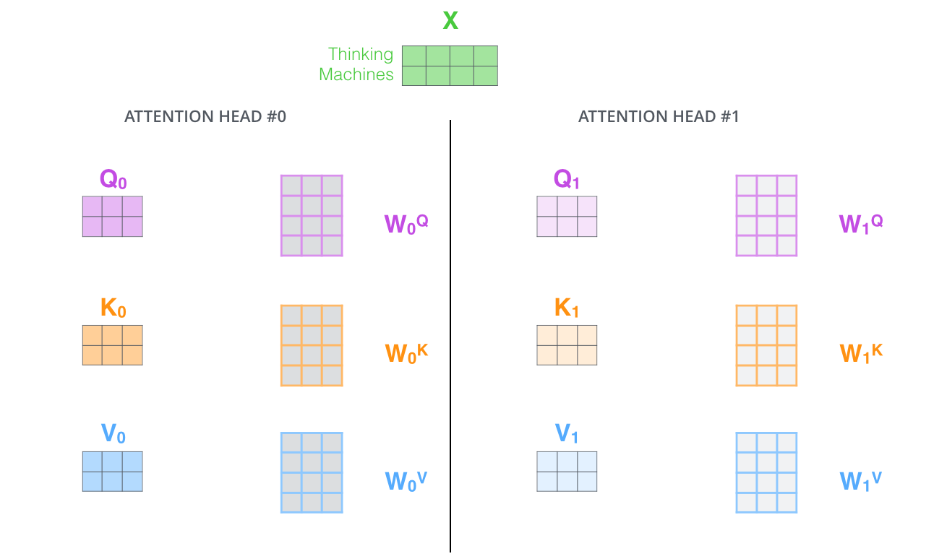
Multi-headed attention
http://jalammar.github.io/illustrated-transformer/

Slide 18
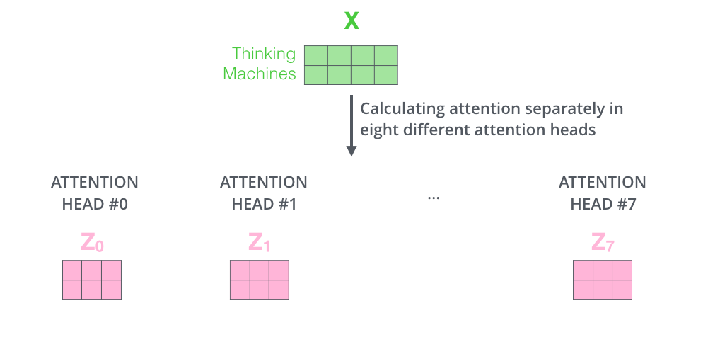
Multi-headed attention
http://jalammar.github.io/illustrated-transformer/

Slide 19
We only need one Z
http://jalammar.github.io/illustrated-transformer/

Slide 20
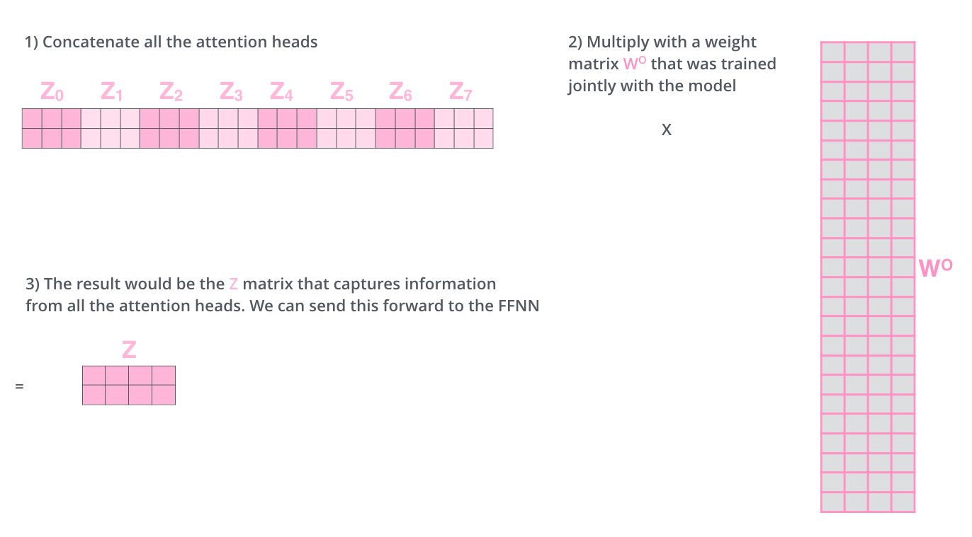
Concatenation and Wo weight matrix
http://jalammar.github.io/illustrated-transformer/

Slide 21
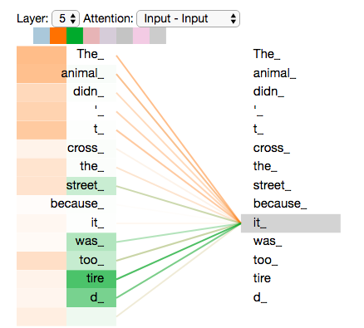
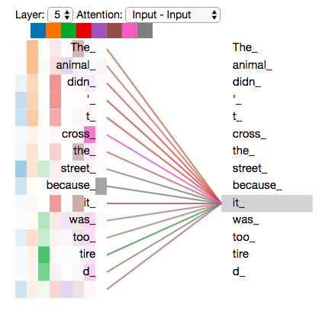
Multi-headed attention visualization
1 Head
2 Heads
8 Heads
http://jalammar.github.io/illustrated-transformer/

Slide 22
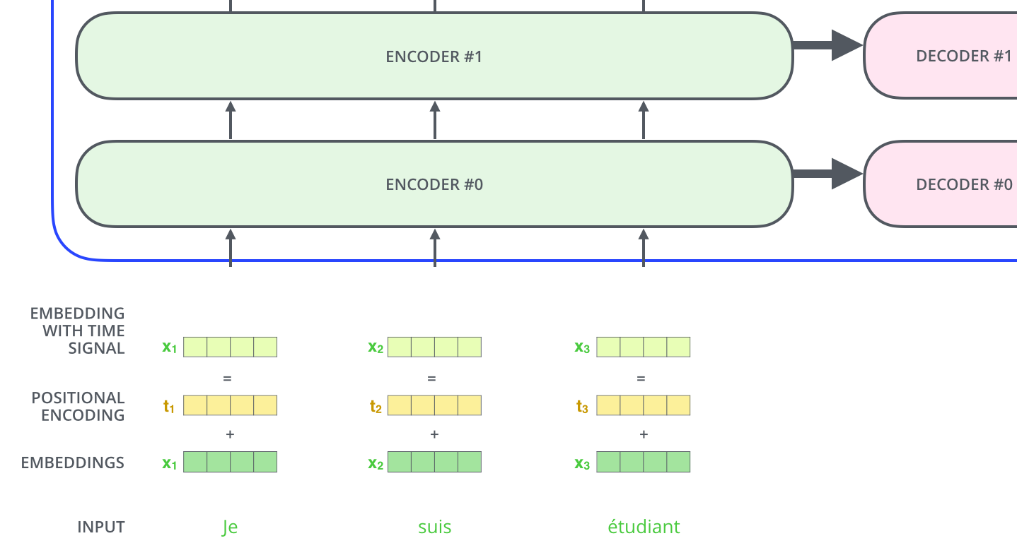
Positional Encoding
http://jalammar.github.io/illustrated-transformer/
https://arxiv.org/abs/1706.03762

Slide 23
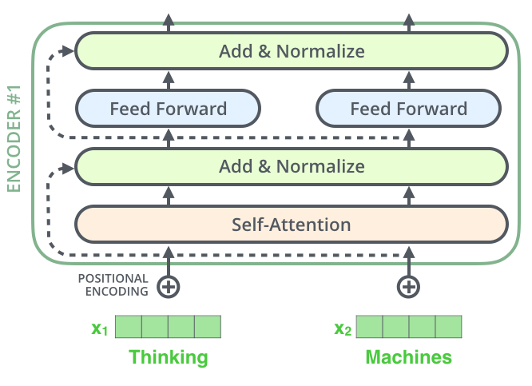
Residual Connections
http://jalammar.github.io/illustrated-transformer/

Slide 24

Encoder Decoder Attention
http://jalammar.github.io/illustrated-transformer/

Slide 25

Encoder Decoder Attention
http://jalammar.github.io/illustrated-transformer/

Slide 26
Encoder Decoder Attention
Creates Queries matrix from the layer below it, and takes the Keys and Values matrix from the encoder stack.
https://arxiv.org/abs/1706.03762

Slide 27
Encoder Attention
Vs
Decoder Attention

Slide 28
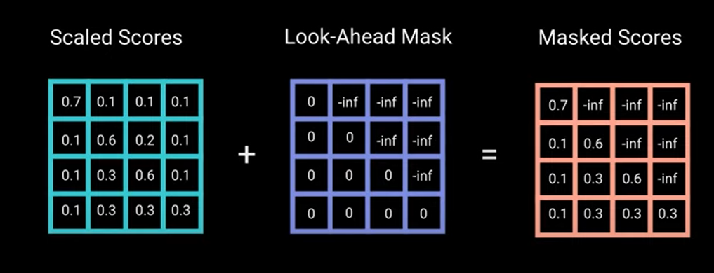
Masking
YT - The A.I. Hacker - Michael Phi

Slide 29
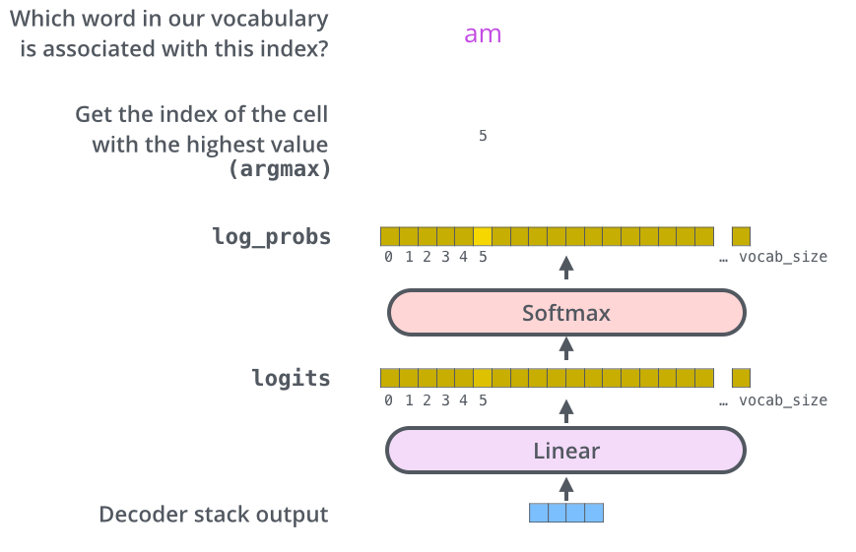
The Final Linear and Softmax Layer
http://jalammar.github.io/illustrated-transformer/
https://arxiv.org/abs/1706.03762

Slide 30
Training
One Hot Encoding
Loss Function
Another Training Method

Slide 31
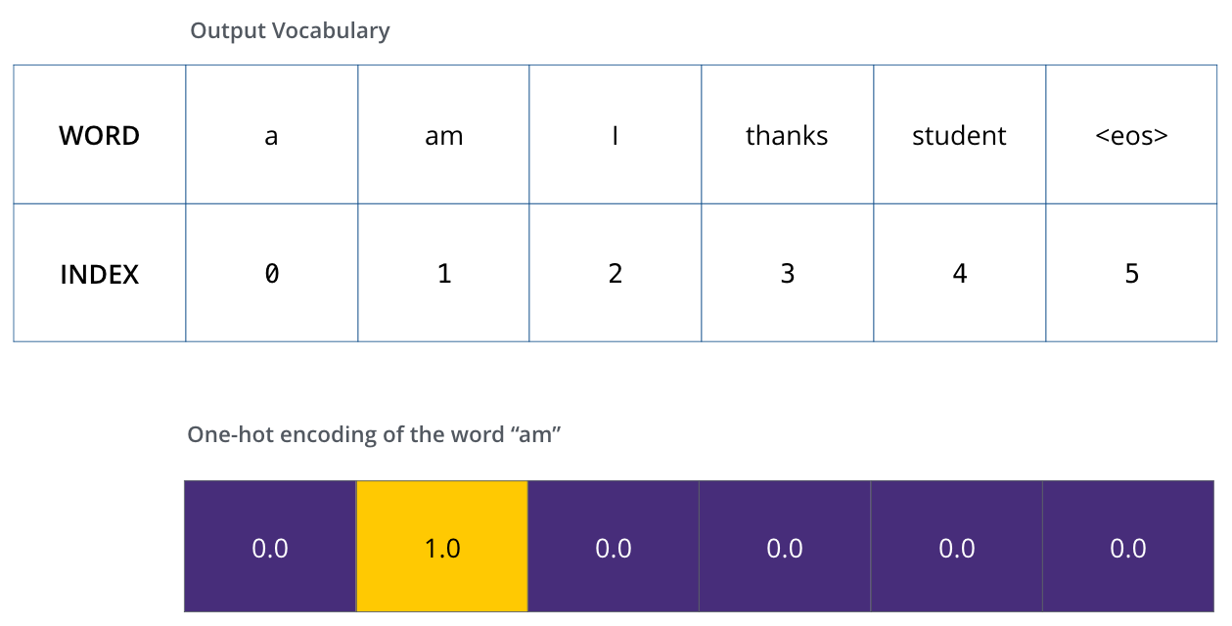
One Hot Encoding
http://jalammar.github.io/illustrated-transformer/

Slide 32
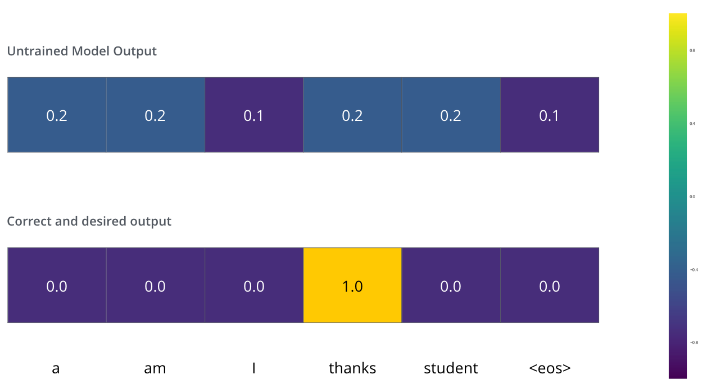
Loss Function
http://jalammar.github.io/illustrated-transformer/

Slide 33
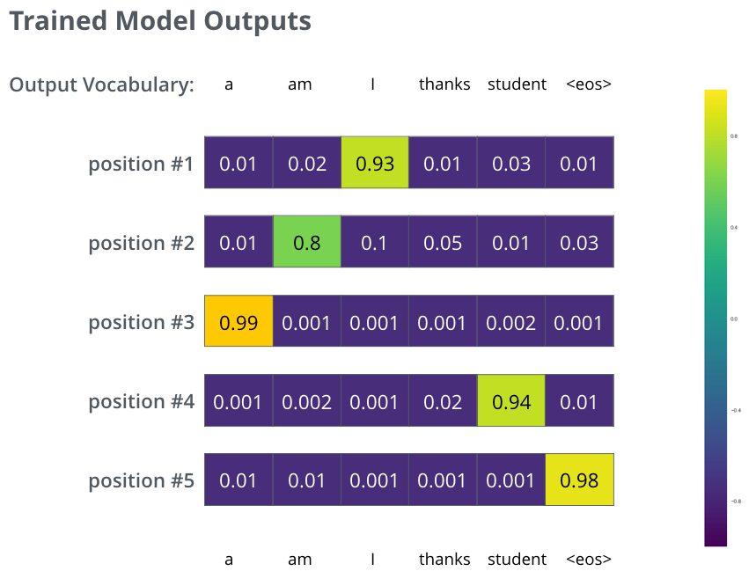
Loss Function
http://jalammar.github.io/illustrated-transformer/

Slide 34

Another Training Method
Another way to do it would be to hold on to, say, the top two words (say, ‘I’ and ‘a’ for example), then in the next step, run the model twice
http://jalammar.github.io/illustrated-transformer/

Slide 35
Resources
Illustrated-transformer
Illustrated Guide to Transformers Neural Network: A step by step explanation
A Deep Dive Into the Transformer Architecture – The Development of Transformer Models
Attention Is All You Need
Transformers and Language Models - YouTube Playlist

Slide 36
Thanks
hasanmahani08@gmail.com
rezadar1378@gmail.com

